Slide 1


Major Project
AdaptiPlan: Intelligent Scenario Modelling for Climate Change Mitigation using Computational Statistical Model
Presented by:
R2142210244- Charu Gupta
R2142210448- Lakshay Agarwal
Mentored By:
Dr. Tanupriya Choudhury

Slide 2
Content
Introduction
Literature Review
Objectives
Methodology
Working Model
Results
Conclusions
References

Slide 3
Introduction
Technical Concepts (Algorithms):
The technical concepts used are:
LSTM (Long Short-Term Memory): It is a type of recurrent neural network (RNN) specialized for time series forecasting. LSTMs excel at capturing long-term dependencies and nonlinear relationships in sequential data, making them ideal for climate forecasting.
LSTM equations revolve around gates (forget gate f_{t}, input gate i_{t}, output gate o_{t}) and cell state updates:
f_{t} = σ(W_{f} [h_{t-1}, x_{t}] + b_{f})
i_{t}= σ(W_{i} [h_{t-1}, x_{t}] + b_{i})
C_{t} = f_{t} * C_{t-1}+ i_{t} * tanh(W_{c} [h_{t-1}, x_{t}] + b_{c})
o_{t} = σ(W_{o} [h_{t-1}, x_{t}] + b_{o})
h_{t} = o_{t} * tanh(C_{t})

Slide 4
Introduction
Technical Concepts (Algorithms):
ARIMA (Auto Regressive Integrated Moving Average): A traditional statistical method used for time series analysis. ARIMA models are effective for univariate time series data with linear trends and seasonality, providing robust forecasts based on past values.
ARIMA combines three components:
AR (AutoRegression): T_{t} ​= ϕ₁​​ T_{t -1}​+ϕ₂​​T_{t -2}+...+ϕ_{p}​T_{t -1p}+ϵ_{t}
I (Integrated): Differencing of the time series to make it stationary.
MA (Moving Average): T_{t}​ = ϵ_{t} ​+θ₁​ ϵ_{t -1}​+...+θ_{q}​ϵ_{t - q}
Final ARIMA model: T_{t}​ = ϕ₁​ ​T_{t-1}​ ​+ θ₁​ ​ϵ_{t -1} +(integrated terms)

Slide 5
Introduction
Technical Concepts (Algorithms):
Monte Carlo Simulation: A stochastic technique that generates a range of possible outcomes by running repeated random simulations. This method is used to understand uncertainties and risks, providing probabilistic climate forecasts.
Monte Carlo simulations generate random samples using probability distributions and then apply repeated simulations:
x_{i}= μ + σ * z_{i}
Where:
μ is the mean
σ is the standard deviation
z_{i} is a random variable following a standard normal distribution

Slide 6
Introduction
Motivation:
The increasing severity and frequency of climate events require reliable tools to predict future climate conditions and their impact on various regions and industries. This project aims to enhance decision-making in climate adaptation by identifying the most accurate and reliable forecasting model for climate scenarios. By comparing LSTM, ARIMA, and Monte Carlo simulation, the project will offer a tool that will help the user to make informed decisions.
Problem Statement:
The goal of this project is to predict future climate scenarios and assess potential risks using advanced machine learning and statistical methods. Specifically, we aim to compare three models LSTM, ARIMA, and Monte Carlo simulation to determine which one provides the most reliable and accurate predictions using time series climate data. The selected model will then be used to develop a web application that allows users to simulate and analyze climate scenarios, helping them make informed decisions for climate adaptation and risk management.

Slide 7
Introduction
Area of application:
Policy Making: Government agencies can use the tool to develop climate change mitigation and adaptation strategies.
Business Strategy: Industries, particularly those in agriculture, energy, and insurance, can use climate scenario forecasts to manage risks and optimize operations.
Environmental Research: Researchers can apply the tool to study long-term climate patterns and evaluate the effectiveness of adaptation measures.
Dataset and input format:
DATASET
The dataset is downloaded in .nc format which is then be converted .csv
There are 23 columns and 92,000 rows. Some of the features are wind speed, precipitation, cloud cover, temperature, etc.

Slide 8
Literature Review
Cite Related work:
[1] explores using Long Short-Term Memory (LSTM) networks to predict daily climate variables like temperature, leveraging historical data from Delhi of two years between 2013-2017. Traditional climate models are computationally intensive and may not capture local patterns well, but LSTM excels at processing time-dependent data. After preprocessing the data, LSTM model was trained, achieving good accuracy with a root mean squared error (RMSE) of 0.78. The results demonstrate the potential for LSTM networks to be applied to more complex climate variables and regions, offering more precise and localized climate forecasts in the future.
[2] explores ARIMA model, a statistical approach, to provide regional temperature and precipitation forecasts based on historical observations for 18 years. The ARIMA model was chosen due to its ability to account for temporal correlation and skewed distributions in climate data, improving forecasting accuracy over simpler methods like linear trends. The model was extended to estimate confidence intervals for temperature and precipitation extremes and simulate daily climate conditions. The predictions made by ARIMA model shows its reliability and adaptability for engineering applications, offering a robust alternative to traditional statistical forecasting methods.

Slide 9
Literature Review
Cite Related work:
[3] gives introduction about Monte Carlo simulation on how it is becoming increasingly recognized for its powerful ability to manage uncertainty and variability in complex models. Unlike deterministic simulation, which offers a single outcome by assuming fixed parameters, Monte Carlo simulation explores a range of possible outcomes by incorporating random variations in the model's inputs. This method provides valuable insights into how different factors can influence results over time, making it a robust tool for understanding and predicting complex systems. Its versatility and effectiveness have made Monte Carlo simulation a staple in various fields, from finance to engineering, and it holds significant promise for enhancing decision-making processes. By capturing the full spectrum of potential scenarios, Monte Carlo simulation offers a deeper understanding of risk and uncertainty, which is increasingly important in today’s data-driven world.
[4] the hybrid LSTM-CM model developed in this study combines the strengths of both machine learning (LSTM-SA) and climate models (GS5) to improve drought prediction accuracy. By using the low bias of LSTM-SA and the strong physical simulation capabilities of GS5, LSTM-CM enhances drought forecasting, especially for 1-, 2-, and 3-month lead times, with improved skill scores ranging from 29.17% to 54.29%. This model shows better performance in detecting drought events with lower uncertainty than the stand-alone models, making it a promising tool for more reliable drought prediction.

Slide 10
Literature Review
Cite Related work:
[5] presents a new hybrid model, LSTM-CM, for predicting droughts by combining a long short-term memory (LSTM) model with a climate model (GloSea5). This model is compared against the standalone LSTM model (LSTM-SA) and the GloSea5 model (GS5) in terms of accuracy, bias, and overall performance. The results show that LSTM-CM outperforms both models by reducing bias, capturing the physical processes accurately, and improving prediction skill scores for 1-, 2-, and 3-month lead times. The LSTM-CM model effectively detects droughts with lower uncertainty, making it a reliable tool for drought forecasting.
[6] presents a method for handling uncertainty in climate change scenarios using a Bayesian Monte-Carlo approach. This method accounts for uncertainties in future greenhouse gas emissions, climate sensitivity, and the limitations of climate models. The model uses various emissions scenarios and climate sensitivities to produce a range of possible future climate conditions. By applying these scenarios to impact models, such as those for hydrology, it provides a probability distribution of outcomes, helping decision-makers assess risks and plan for various future climate conditions. This approach enhances understanding and management of uncertainty in climate impact assessments.

Slide 11
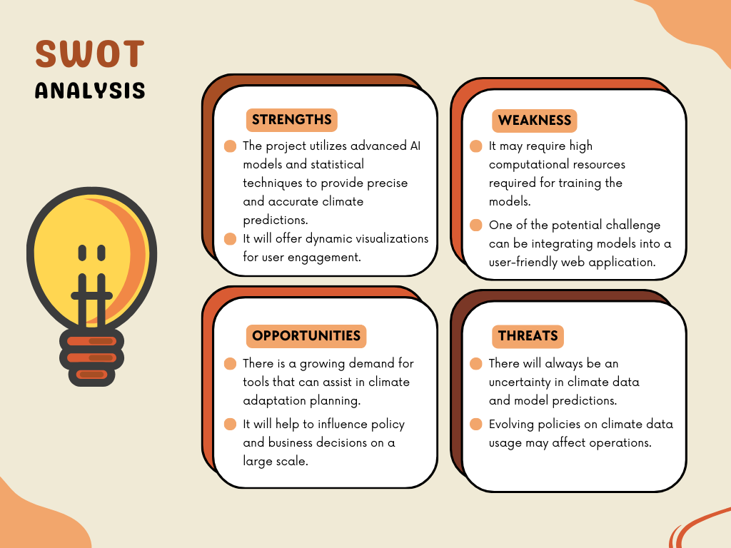
Literature Review

Slide 12
Objective
Main Objective:
The core objective of this project is to develop a predictive model for climate change impacts and integrate it into an interactive web application to assist users in making informed decisions for climate adaptation.
Sub Objective:
Finding the dataset
Implementing the models
Evaluating and performing comparative analysis
Building the web application using the best model

Slide 13
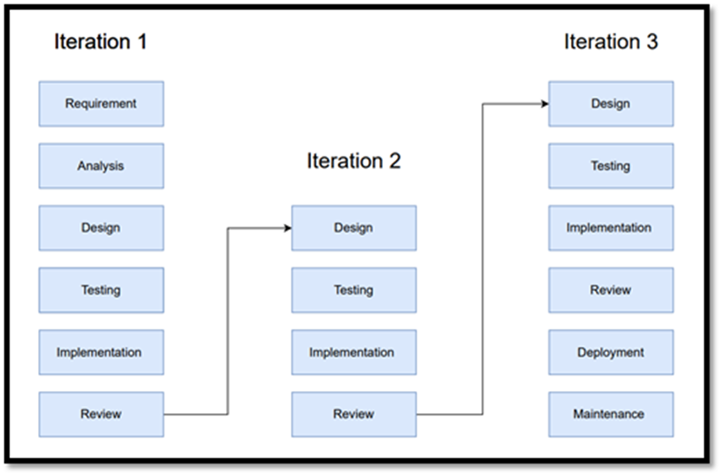
Methodology
Reference Software model
We will be using the Iterative Model to implement our project. The iterative method begins with a basic implementation of a limited set of software requirements in the iterative model, then repeatedly improves the evolving versions until the entire system is built and prepared for deployment.

Slide 14
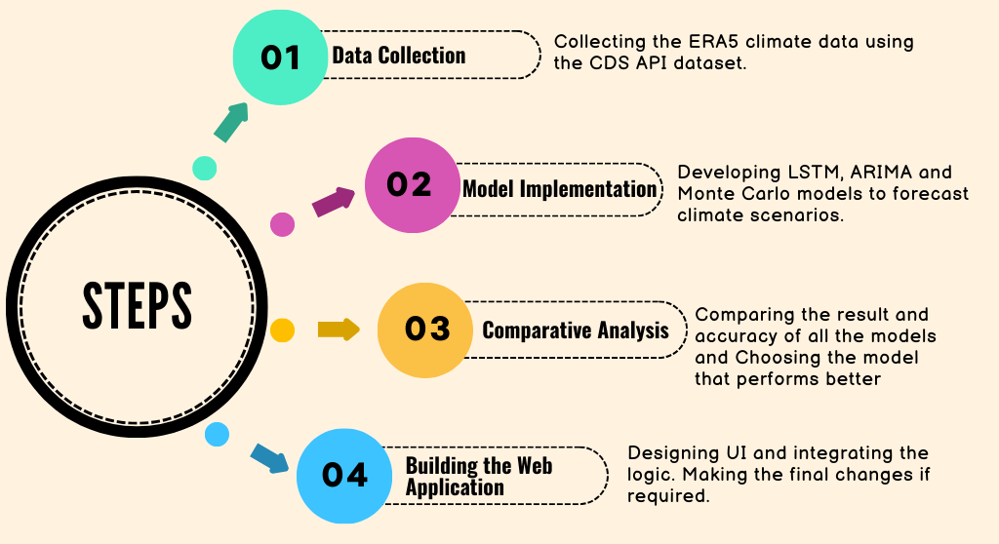
Methodology

Slide 15
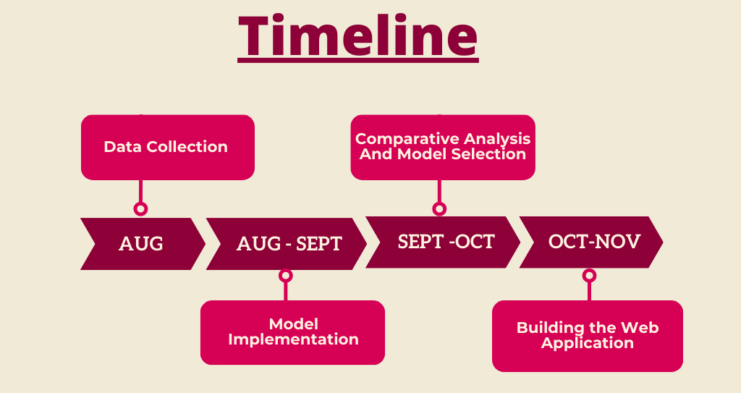
Methodology

Slide 16
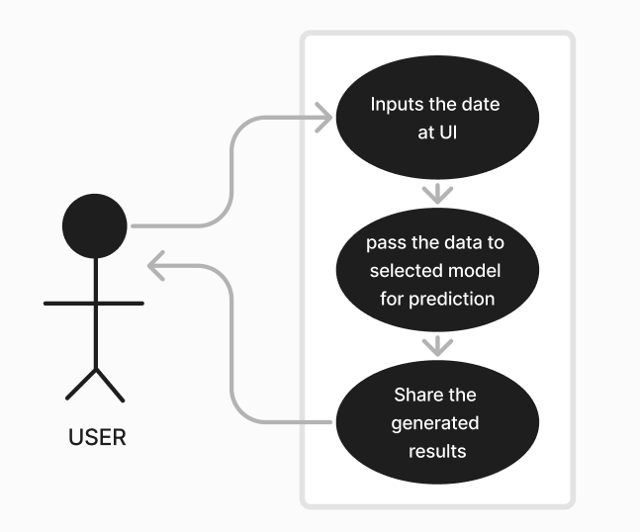
Working Model
Requirement analysis (Link of SRS): SRS
Technical Diagram:
UML Diagram:

Slide 17
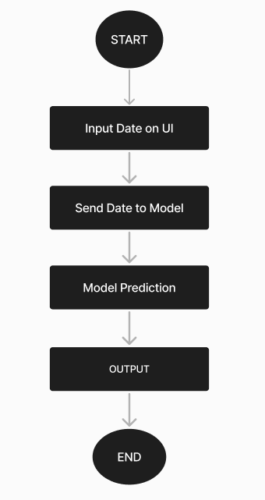
Working Model
Technical Diagram:
Flowchart:

Slide 18
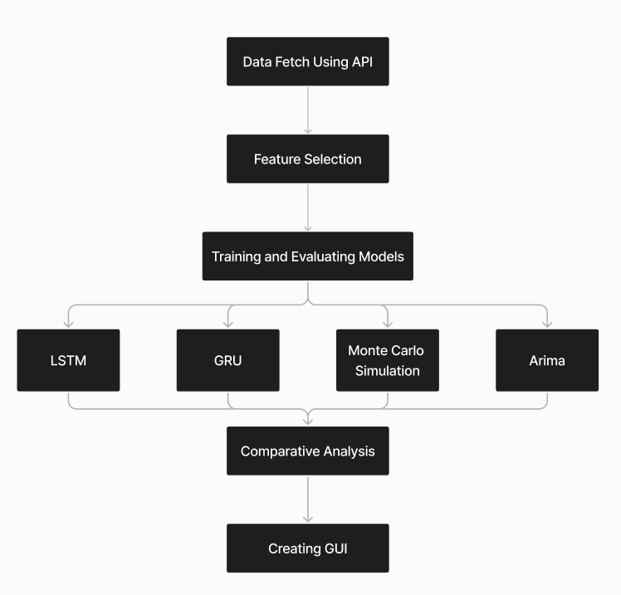
Working Model
Working Module:

Slide 19
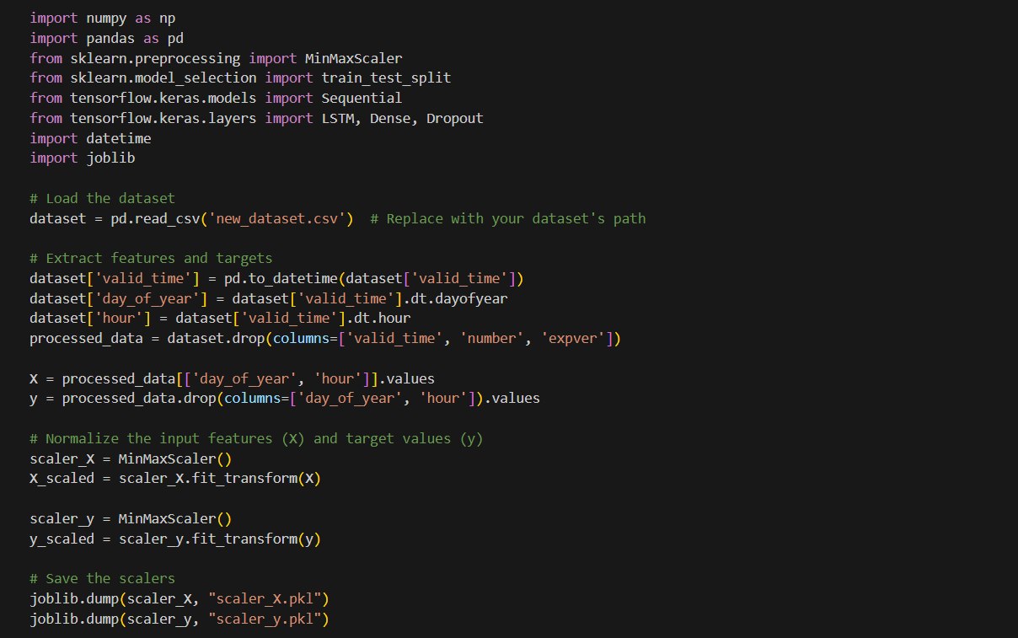
Results
Code:

Slide 20
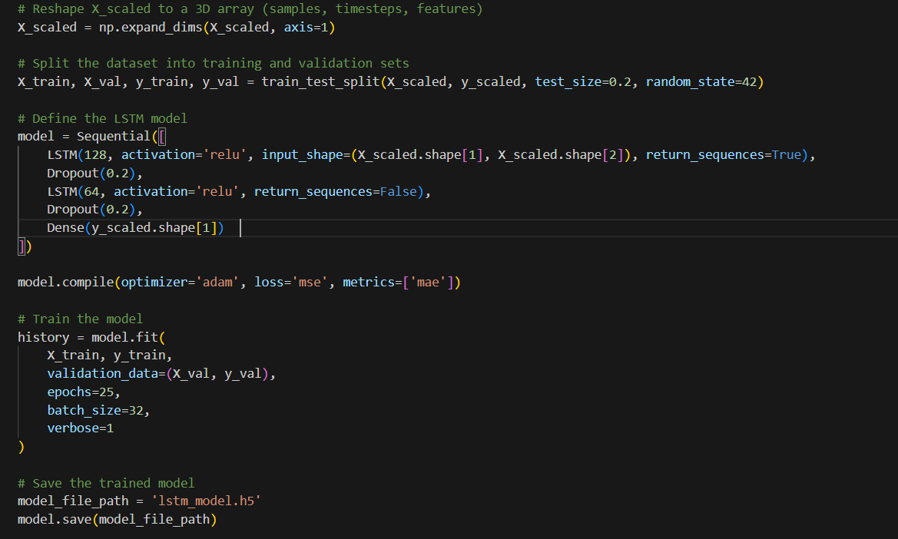
Results

Slide 21
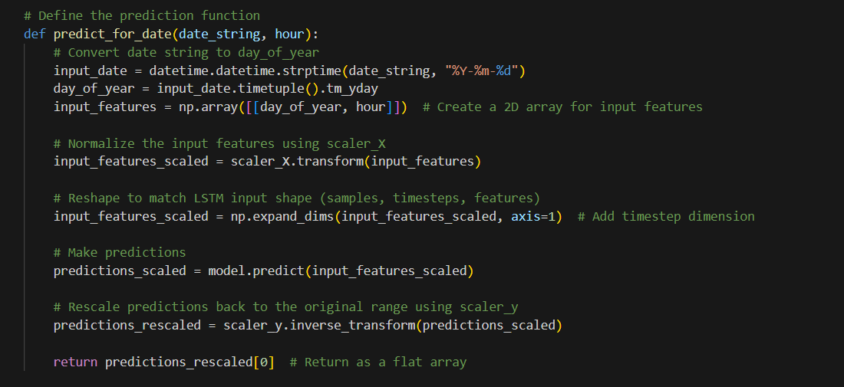
Results

Slide 22
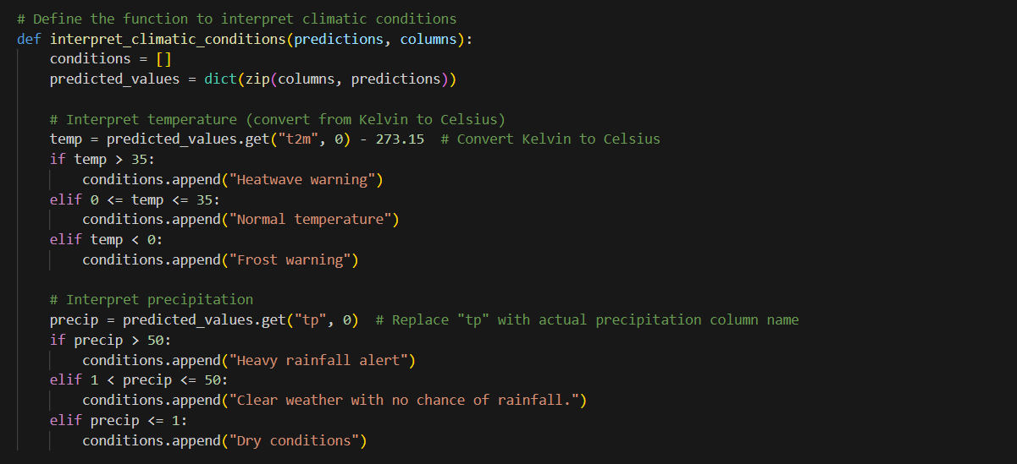
Results

Slide 23
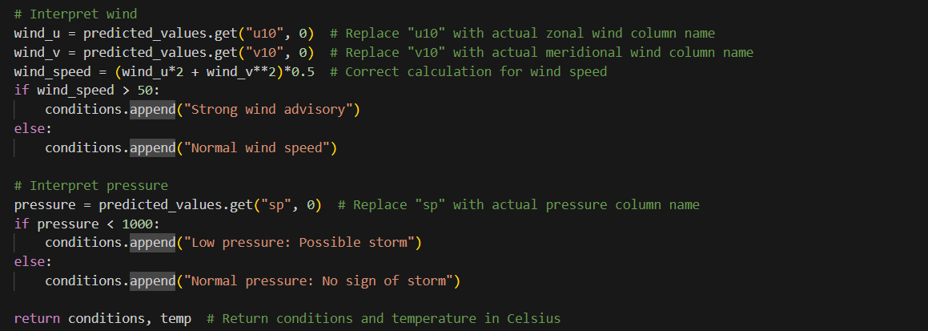
Results

Slide 24
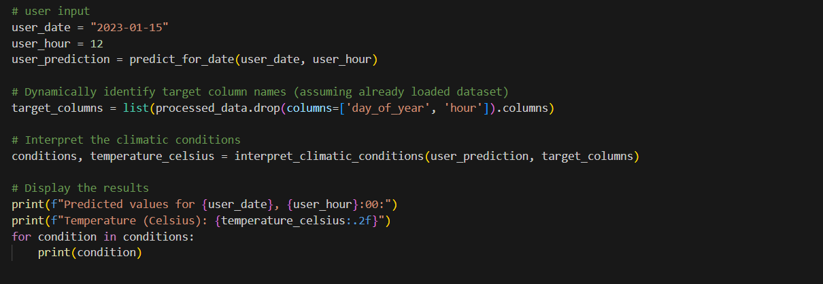
Results

Slide 25
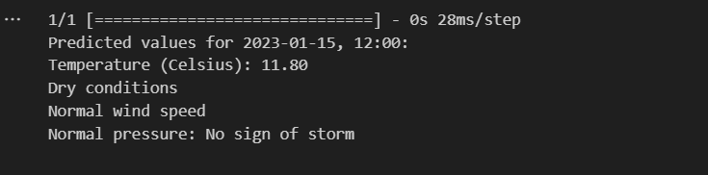
Results

Slide 26
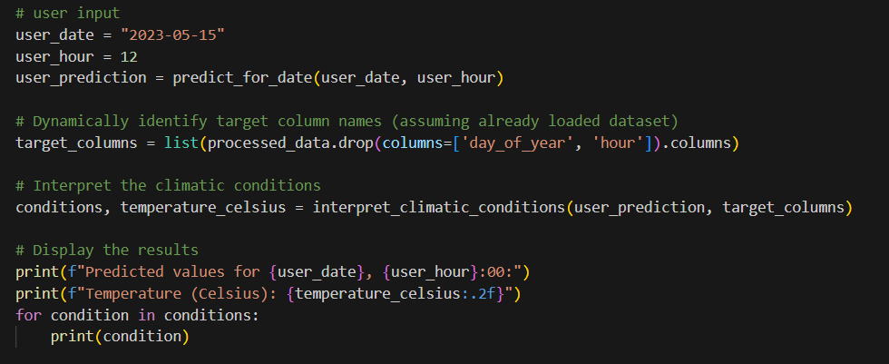
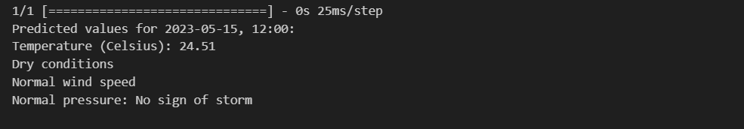
Results

Slide 27
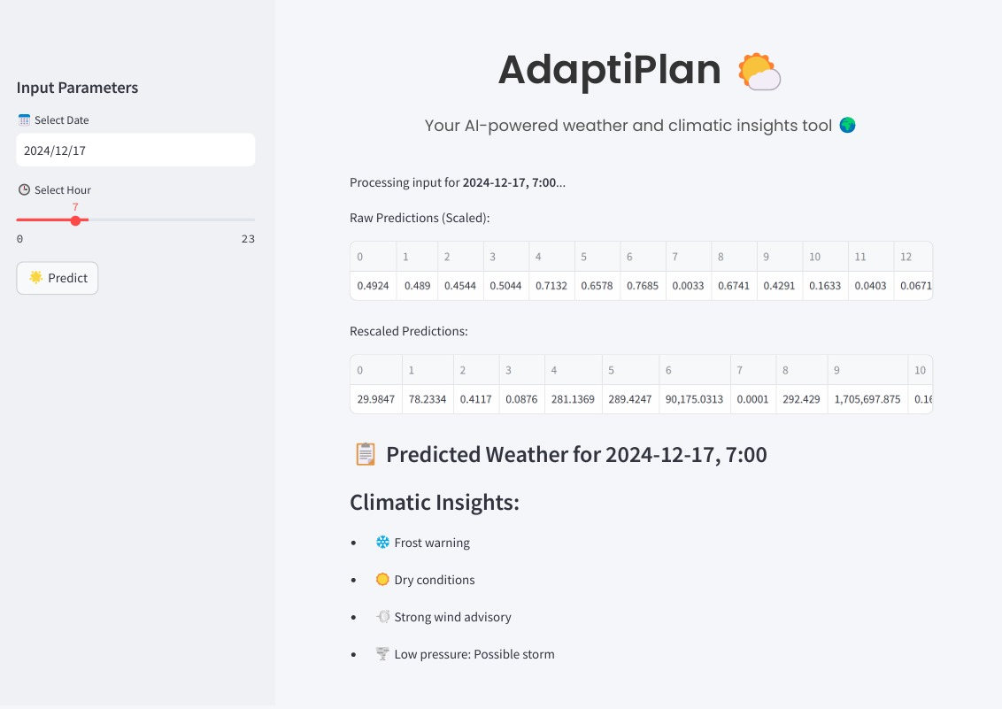
Results

Slide 28
Conclusion
Models | Architecture | Computational Complexity | MSE for Event’s Prediction
LSTM | Recurrent Neural Network with Long Short-Term Memory units | Moderate, due to sequential dependencies and time steps | It gave the best results.
ARIMA | Statistical model (AutoRegressive Integrated Moving Average) | Lower, but can be computationally expensive with high-order models | It performed better than Monte Carlo but worse than LSTM
Monte Carlo Simulation | Probabilistic model based on random sampling and repeated experiments | Depends on the number of simulations (can be high) | It was not good comparing other two models.

Slide 29
Reference
List of cited papers
[1] Xu, J., Wang, Z., Li, X., Li, Z., & Li, Z. (2024). Prediction of Daily Climate Using Long Short-Term Memory (LSTM) Model. International Journal of Innovative Science and Research Technology, 83-90.
[2] Lai, Y., & Dzombak, D. A. (2020). Use of the autoregressive integrated moving average (ARIMA) model to forecast near-term regional temperature and precipitation. Weather and forecasting, 35(3), 959-976.
[3] Bonate, P. L. (2001). A brief introduction to Monte Carlo simulation. Clinical pharmacokinetics, 40, 15-22.
[4] Vo, T. Q., Kim, S. H., Nguyen, D. H., & Bae, D. H. (2023). LSTM-CM: a hybrid approach for natural drought prediction based on deep learning and climate models. Stochastic Environmental Research and Risk Assessment, 37(6), 2035-2051.
[5] Dimri, T., Ahmad, S., & Sharif, M. (2020). Time series analysis of climate variables using seasonal ARIMA approach. Journal of Earth System Science, 129, 1-16.
[6] New, M., & Hulme, M. (2000). Representing uncertainty in climate change scenarios: a Monte-Carlo approach. Integrated assessment, 1(3), 203-213.

Slide 30
Thank You

